Slide 1

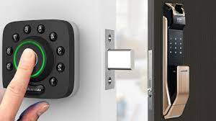
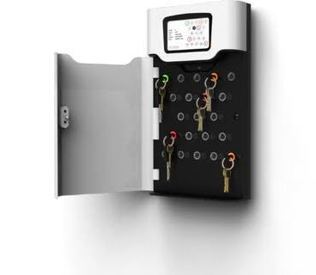
Smart-Doorlock
Coded by: Stephen Peterson
Original Developer: Vipul Kumar
A doorlock with multi-user functions , touch screen ability, and home safety features.
https://github.com/ksu-is/smart-doorlock

